Slide 1

Introduction to Robotics
2016 Fall

Slide 2
Transfer programs to mBot from Computer
1. Remove the default programs: upload a new program
2. Recover the default programs: connect → reset default program
3. Transfer program to mBot → mBot program → upload

Slide 3
The Software Development Process
1. Requirements
2. Analysis
3. Design
4. Implementation
5. Testing and Debugging

Slide 4
Project: push the button to play music Requirement
The requirements for this program are:
1. The program should wait for the push button to be pressed.
2. When the button is pressed, play the following sequence of notes:
E4 D4 C4 D4 E4 E4 E4 R D4 D4 D4 R E4 G4 G4
The R represents a rest, or pause, in the melody.

Slide 5
Analysis
Having already written a program that plays a list of notes, the only differences we see are the addition of the “R” to indicate a rest, or pause, and the need to wait for the push button to be pressed to start playing the melody. So let’s move on to design.

Slide 6
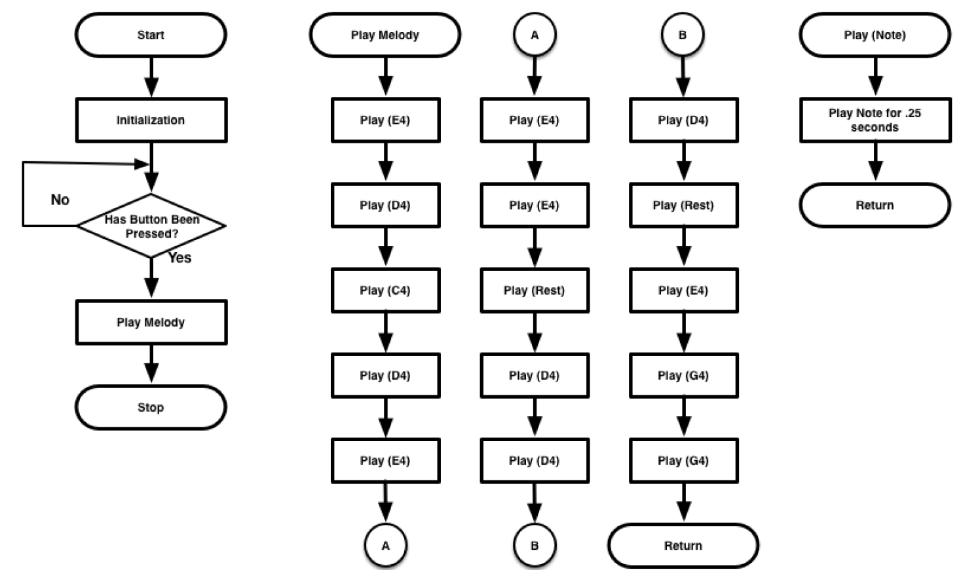
Design

Slide 7
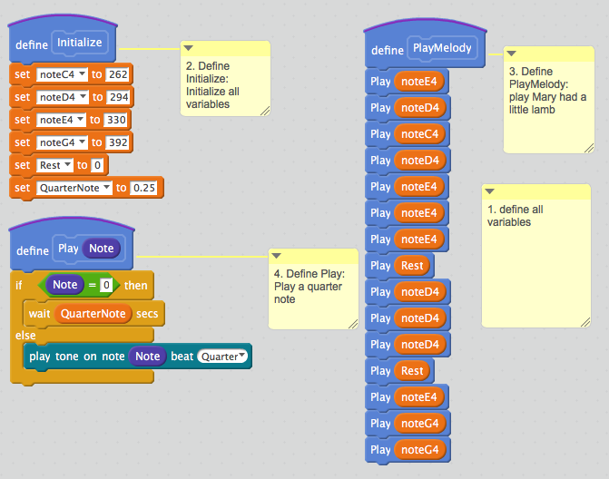
Implementation 1

Slide 8
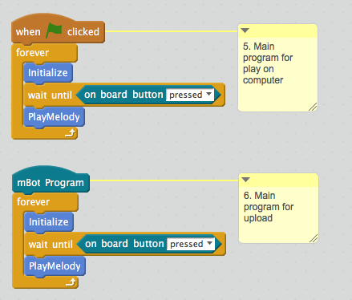
Implementation 2

Slide 9
Testing and Debugging
Testing Procedure
1. Press the green button on the robot and you should hear a familiar melody.
2. Does the mBot wait to play the melody until the button is pressed?
3. Does the melody play after the button is pressed?
If your program fulfills all of the test conditions, it has passed. Congratulations!

Slide 10
